Slide 1
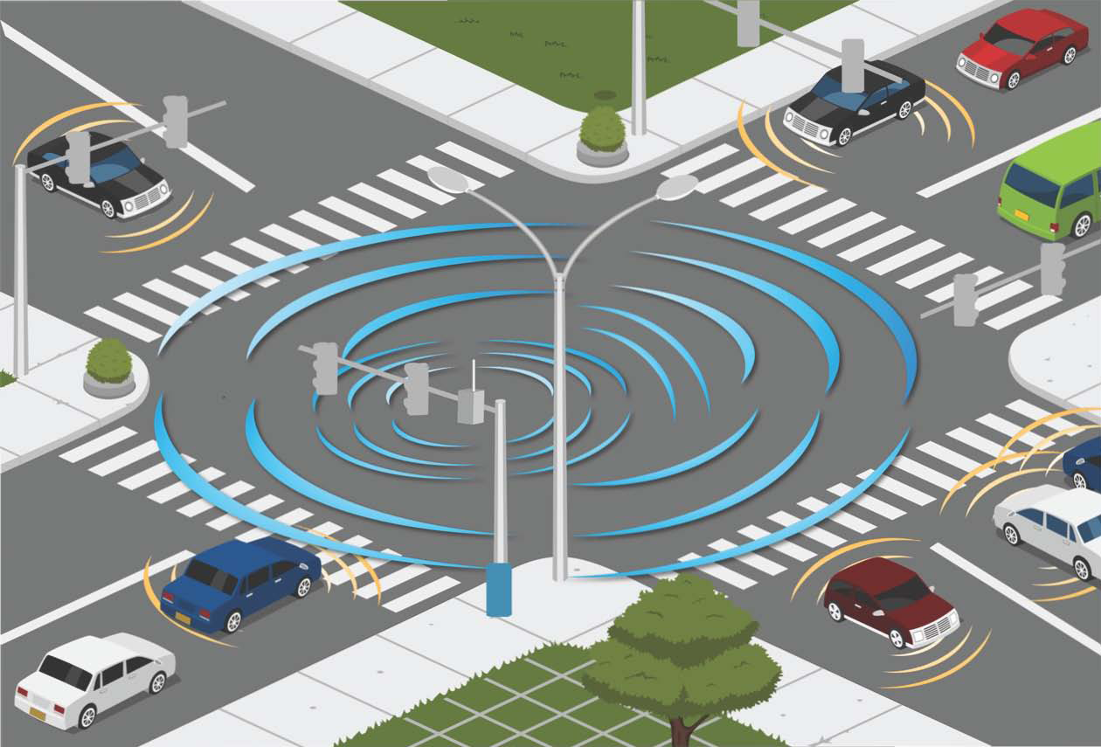
ON SOME GRAPH RELATED PROBLEMS
IN TRANSPORTATION ANALYSIS
Jaume Barceló, Mª Paz Linares, Oriol Serch
jaume.barcelo@upc.edu, mari.paz.linares@upc.edu, oriol.serch@upc.edu
Department of Statistics and Operations Research
inLabFIB
UNIVERSITAT POLITÈCNICA DE CATALUNYA-BARCELONA TECH

Slide 2
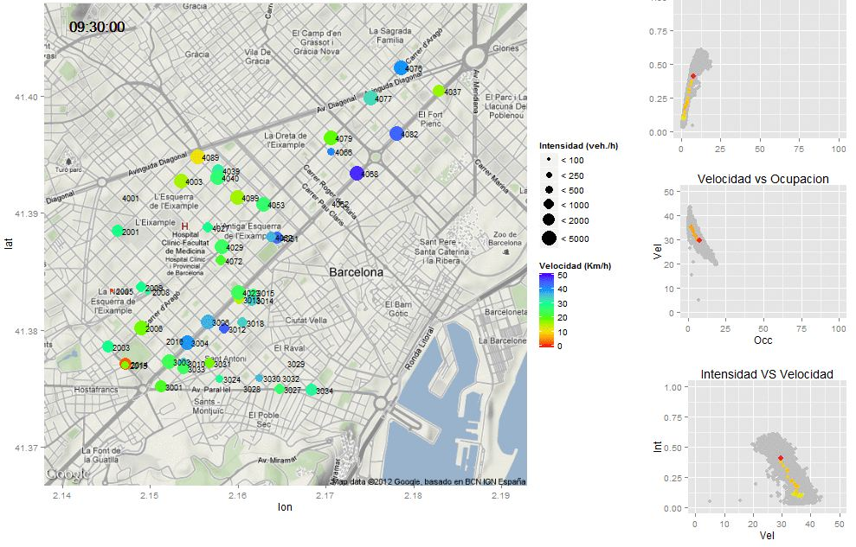
Efficient Data Processing leads to accurate, high added value, reliable information
THE PROBLEM
Smartness ≈
Efficient Data Gathering (Technology) +
Efficient Data Processing (Computational Models)
DATA
INFORMATION
HOW MANY? / WHERE?
PURPOSE?
CITY: Transport Infrastructure + Sensor Network:
Static (Loop, AVI, CCTV, …)
Mobile: persons, vehicles
CITY:
Active Traffic Management
Advanced Mobile Services

Slide 3
EXAMPLES OF SENSOR LOCATION
A) Sensors in streets
Magnetometres detect all vehicles coming from (1), (3) and (4), but not the ones coming from (2) y (5)
B) Sensors on intersections
The Bluetooth/Wifi sensor (red circle) and its detection lobule (yellow area) intercepts part of the vehicles following all routes
C) Optimum: Hybrid layout – sensors both in streets and intersections

Slide 4
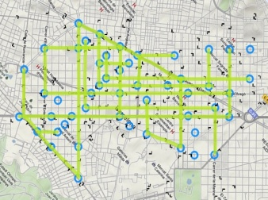

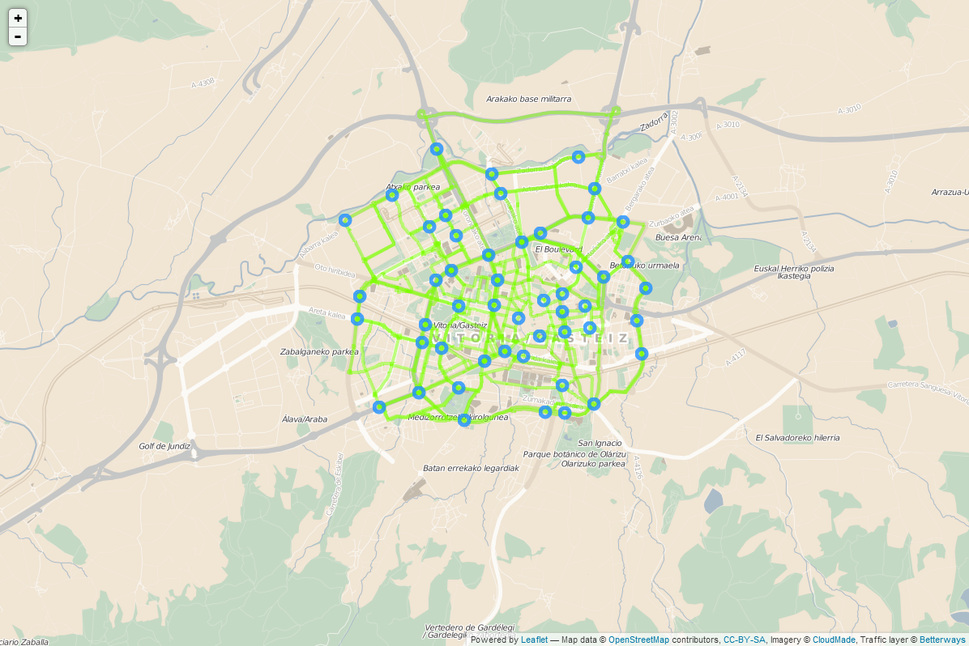
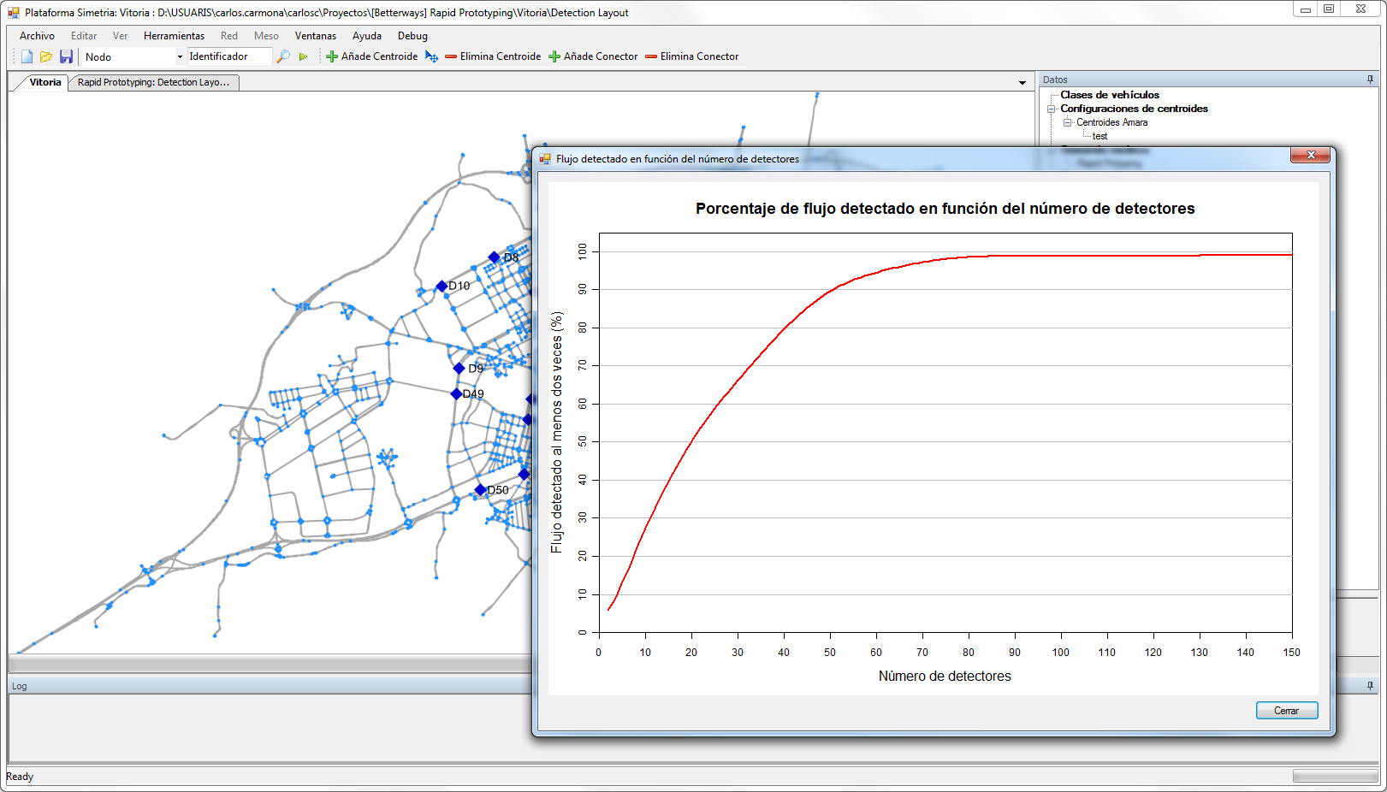
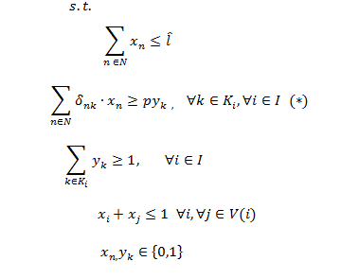
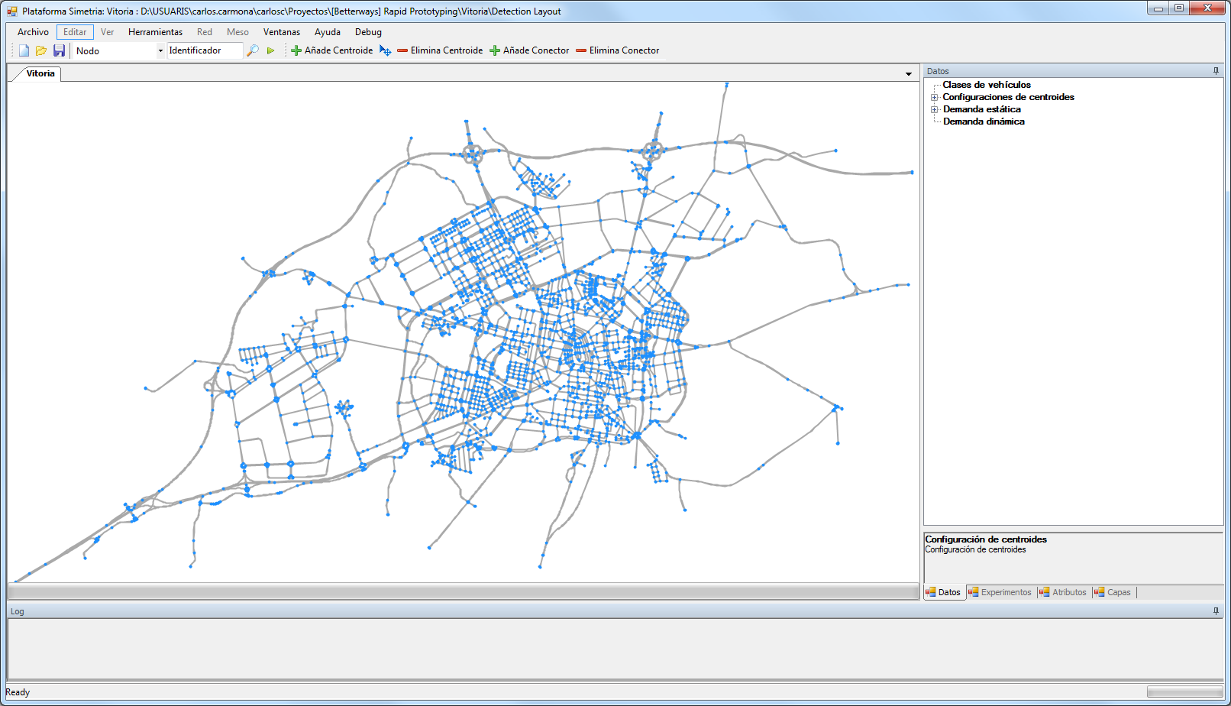
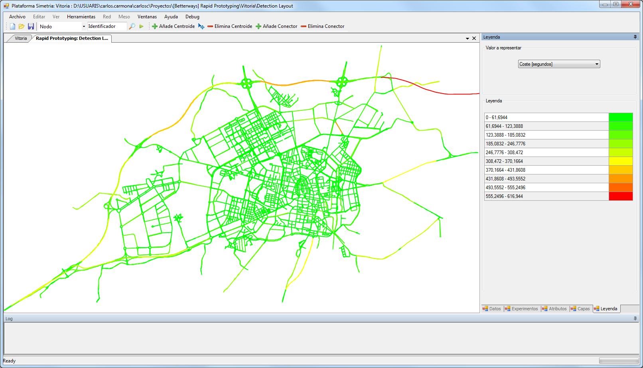
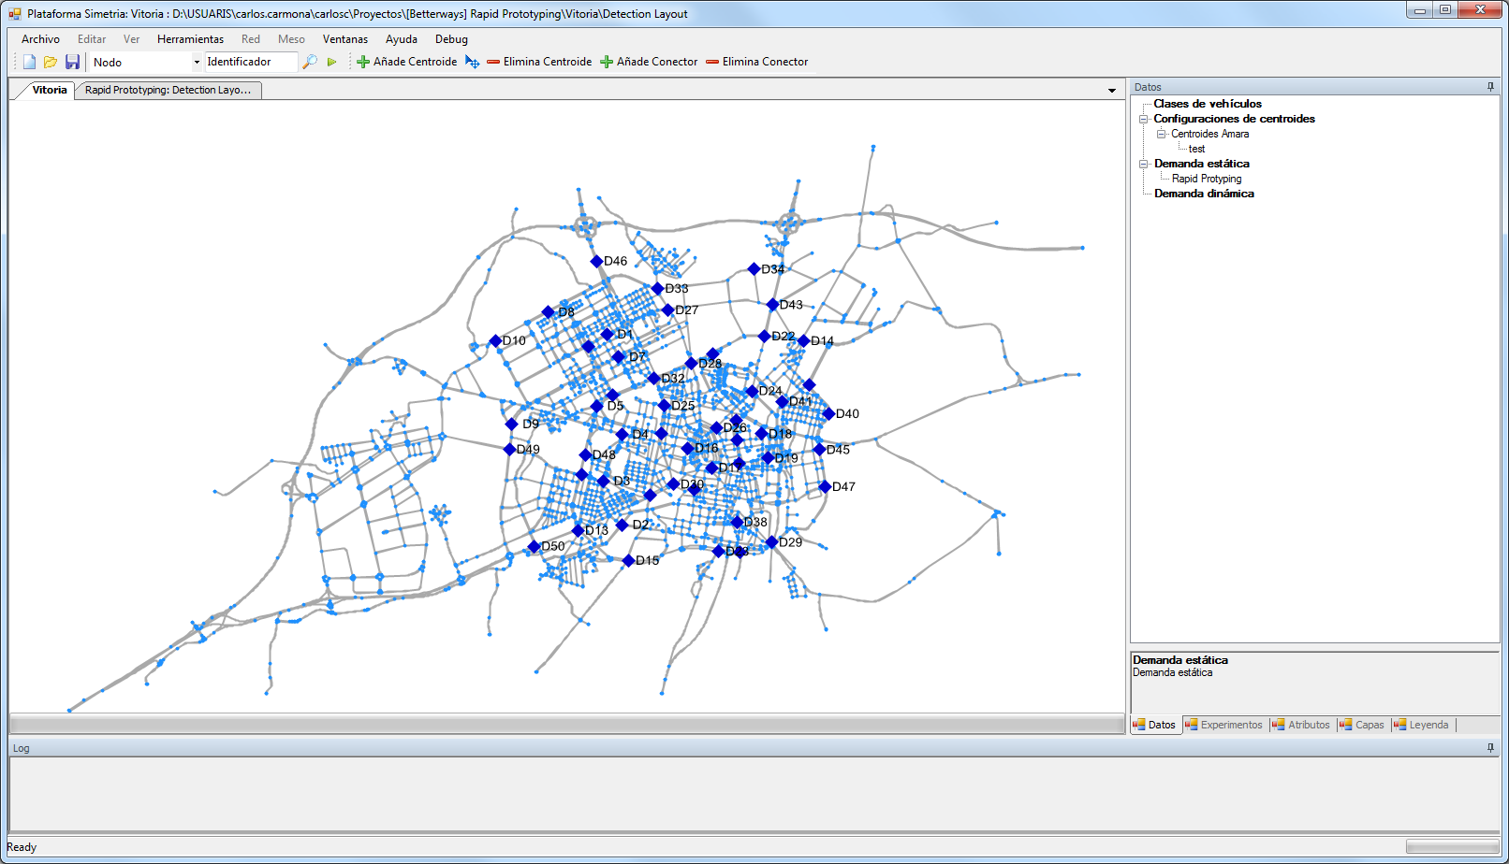
FORMULATING THE SOLUTION
GENERATE
THE CITY’S BASIC
MODEL: COMPLETE GRAPH OF THE TRANSPORT NETWORK
PLAUSIBLE PATHS IDENTIFICATION
PATH FLOW IDENTIFICATION
LOCATION MODELS (DEPENDING ON CRITERIA) FOR SENSOR DEPLOYMENT
BASE OF LOCATION ALGORITHMS ACCORDING TO MODEL
HEURISTIC SOLUTIONS
QUALITY ANALYSIS OF THE LAYOUT IN RELATION TO THE SENSORIZATION’S OBJECTIVES
SPECIFIC CRITERIA FOR SENSOR DEPLOYMENT
PARTIAL PATHS CAN BE RECONSTRUCTED FROM THE POSITION OF THE SENSORS ⇒ DIRECT GENERATION OF TRAVEL TIMES WITH BLUETOOTH SENSORS

Slide 5
EACH LAYOUT PROPOSAL REQUIRES AN ADEQUATE MODEL
LOCATING TRAFFIC SENSORS AT LINKS
Model for the maximization of the overall flow and intercepted OD pairs for the location in sections
LINK COVERING OPTIMIZATION PROBLEM IN THE UNDERLYING GRAPH
LOCATING TRAFFIC SENSORS AT INTERSECTIONS
NODE COVERING OPTIMIZATION PROBLEM ON GRAPHS

Slide 6
COMPARATIVE RESULTS OF THE EXACT AND HEURISTIC SOLUTIONS WITH ADDITIONAL CONSTRAINTS FOR THREE NETWORKS
(Preston, UK, Barcelona, ES, Hessen, D)
 |  | Greedy |  | CPLEX |  | Tabu Search
 | Nb detectors | Flow frac. | Constraints | Flow frac. | Constraints | Flow frac. | Gap red. | Constraints | Gap red.
Preston | 20 | 99.4% | 412/437 | 99.5% | 429/437 | 99.3% | -75% | 429/437 | 100%
 | 25 | 99.8% | 428/437 | <99.9% | 435/437 | 99.9% | 83.3% | 435/437 | 100%
 | 27 | 99.9% | 433/437 | 100% | 437/437 | >99.9% | 85.7% | 436/437 | 75%
 | 30 | 100% | 437/437 | 100% | 437/437 | 100% | - | 437/437 | -
Barcelona | 100 | 99.6% | 1964/2045 | 99.2% | 2028/2045 | 99.1% | NA | 2023/2045 | 98.9%
 | 115 | 99.9% | 2012/2045 | 99.1% | 2045/2045 | 99.7% | 78.7% | 2039/2045 | 99.7%
 | 120 | 99.9% | 2021/2045 | ~100% | 2045/2045 | 99.8% | -241% | 2044/2045 | >99.9%
 | 130 | ~100% | 2032/2045 | 100% | 2045/2045 | ~100% | 91.3% | 2045/2045 | 100%
Hessen | 325 | 99.9% | 14111/14169 | >99.9% | 14165/14169 | >99.9% | 87.3% | 14156/14169 | 83.3%
 | 330 | 99.9% | 14120/14169 | >99.9% | 14169/14169 | >99.9% | 78.5% | 14164/14169 | 82.8%
 | 340 | >99.9% | 14137/14169 | 100% | 14169/14169 | >99.9% | 83.6% | 14169/14169 | 100%
 | 350 | >99.9% | 14149/14169 | 100% | 14169/14169 | 100% | 100% | 14169/14169 | 100%
Preston: 417 links, 166 nodes, 34 Centroids
Barcelona: 1570 links, 692 nodes, 210 Centroids
Hessen: 4282 links, 495 nodes, 245 Centroids

Slide 7
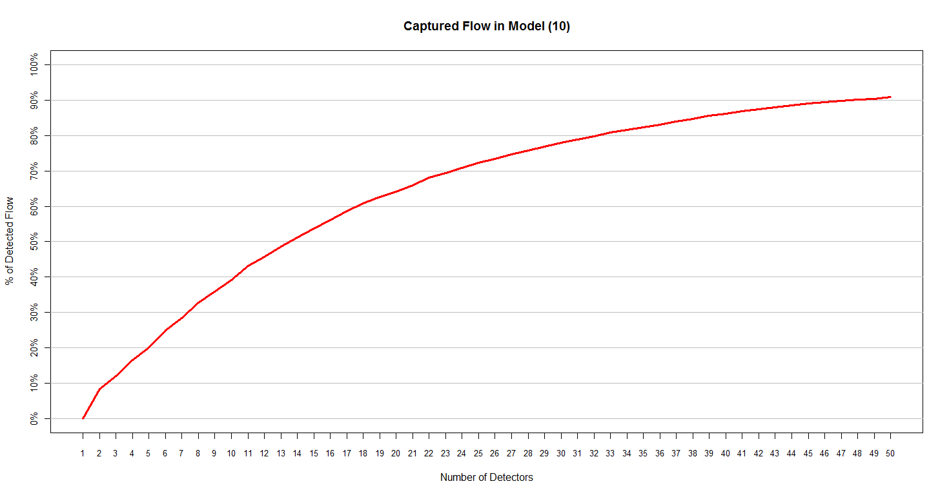

EXAMPLE FOR THE LOCATION OF BLUETOOTH SENSORS IN INTERSECTIONS
Percentage of the overall quantity of intercepted vehicles as a function of the number and location of the sensors
Optimum location of 50 sensors at Barcelona’s Ensanche neighborhood and the main intercepted routes

Slide 8
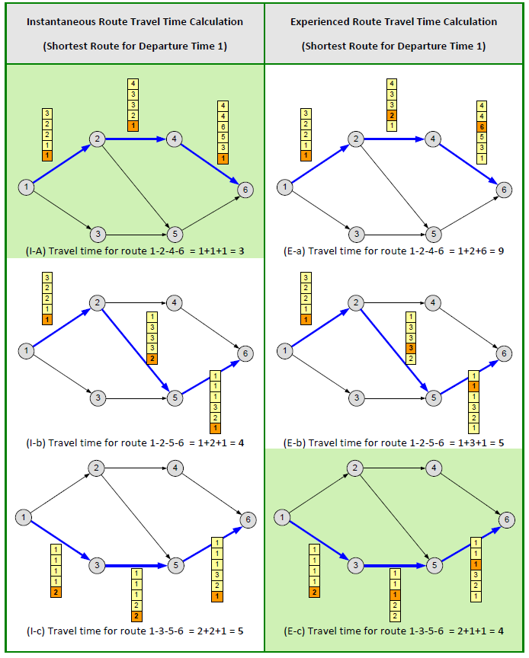
DEALING WITH TIME-DEPENDENT TRAVEL TIMES IN TRANPORTATION NETWORKS: FINDING THE MOST LIKELY USED PATHS
d_{i} = departure time from client i
s_{i} = sevice time for client i
T_{ij}(d_{i}) = travel time from i to j when departing at time d_{i} from client i
T_{ij}(d_{i})≠ T_{ij}(d_{i}’)

Slide 9
DECREASING ORDER OF TIME (DOT) (Chabini 1998)
DOT solves the all-to-one shortest path for all departure times.
Assumptions:
  FIFO property on each link of the road network.
  After certain time horizon T, all arc costs remain constant.
Backwards procedure starting with calculation of static shortest paths at time T.
Notation
Algorithm
q = destination node
n = number of nodes on the network
d_{ij}(t) = travel time between nodes i and j when departure time is t, t ∈ {0,1,…,T}
C_{it} = Cost of optimal path from node i to node q when departure time from i is t.
N_{it} = Next node on the optimal path from node i to node q departing at time t.
Initialization
For i = 1 to n do:
For t = 0 to T do:
C[i][t] ⬅ ∞
N[i][t] ⬅ ∅ For t = 0 to T do:
C[q][t] ⬅ 0
Compute static shortest paths for t = T
2. Main loop:
For t = T – 1 down to 0 do:
For (i,j) ∈A do:
t* = min{ T, t + d_{ij}(t) }
if C[i][t] > C[j][t*] + d_{ij}(t) then:
C[i][t] ⬅ C[j][t*] + d_{ij}(t)
N[i][t] ⬅ j
Notes:
So, in order to deal with this issue, we did some research on the state of the art of time-dependent shortest paths and found the decreasing order of time algorithm proposed by Chabini in 1998 which solved the all-to-one time-dependent shortest path in optimal time.
The DOT algorithm has two basic assumptions. First, all links on the network must show the FIFO property, that means that if vehicle B departs one time period later than vehicle A, vehicle B will arrive later or at the same time as vehicle A at their destination, but not before.
The other assumption is that all arc costs remain constant after certain time T. Therefore, the algorithm is a backwards procedure that starts at time T with the computation of static shortest paths and then moves backwards, period to period, calculating, for each node in the road network, the next node in the shortest path to destination node q and, the cost of the optimal path to destination node q

Slide 10
TIME-DEPENDENT SP’S: IMPLEMENTATION ISSUES
Example:
  Matrix C: stores the cost of traveling from node i to destination node q when departure time is j,
  node i is determined by the row index and time period j is determined by the column index.
  Let’s assume a network with 2000 nodes and 500 time periods
  Matrix C ➔ 1 million entries ➔ 4 megabytes.
  Problem: 2000 C-matrices in memory ➔ 7.5 Gb RAM
Notes:
Implementing DOT in a computer program is very easy. The tough part is to deal with the large amount of information that stems from large road networks.
For example, let us take a look at Matrix C, which stores the cost of traveling from node I to node q when departure time is j, where I is determined by the row index and j is determined by the column index. If we have a large network, let’s say, more than 2000 nodes with 500 time periods, Matrix C could be as large as 1 million entries, or in computational terms, as large as 4 megabytes. The problem is that if we wish to save 2000 of these matrices in memory we will need 7.5 gigabytes of RAM

Slide 11
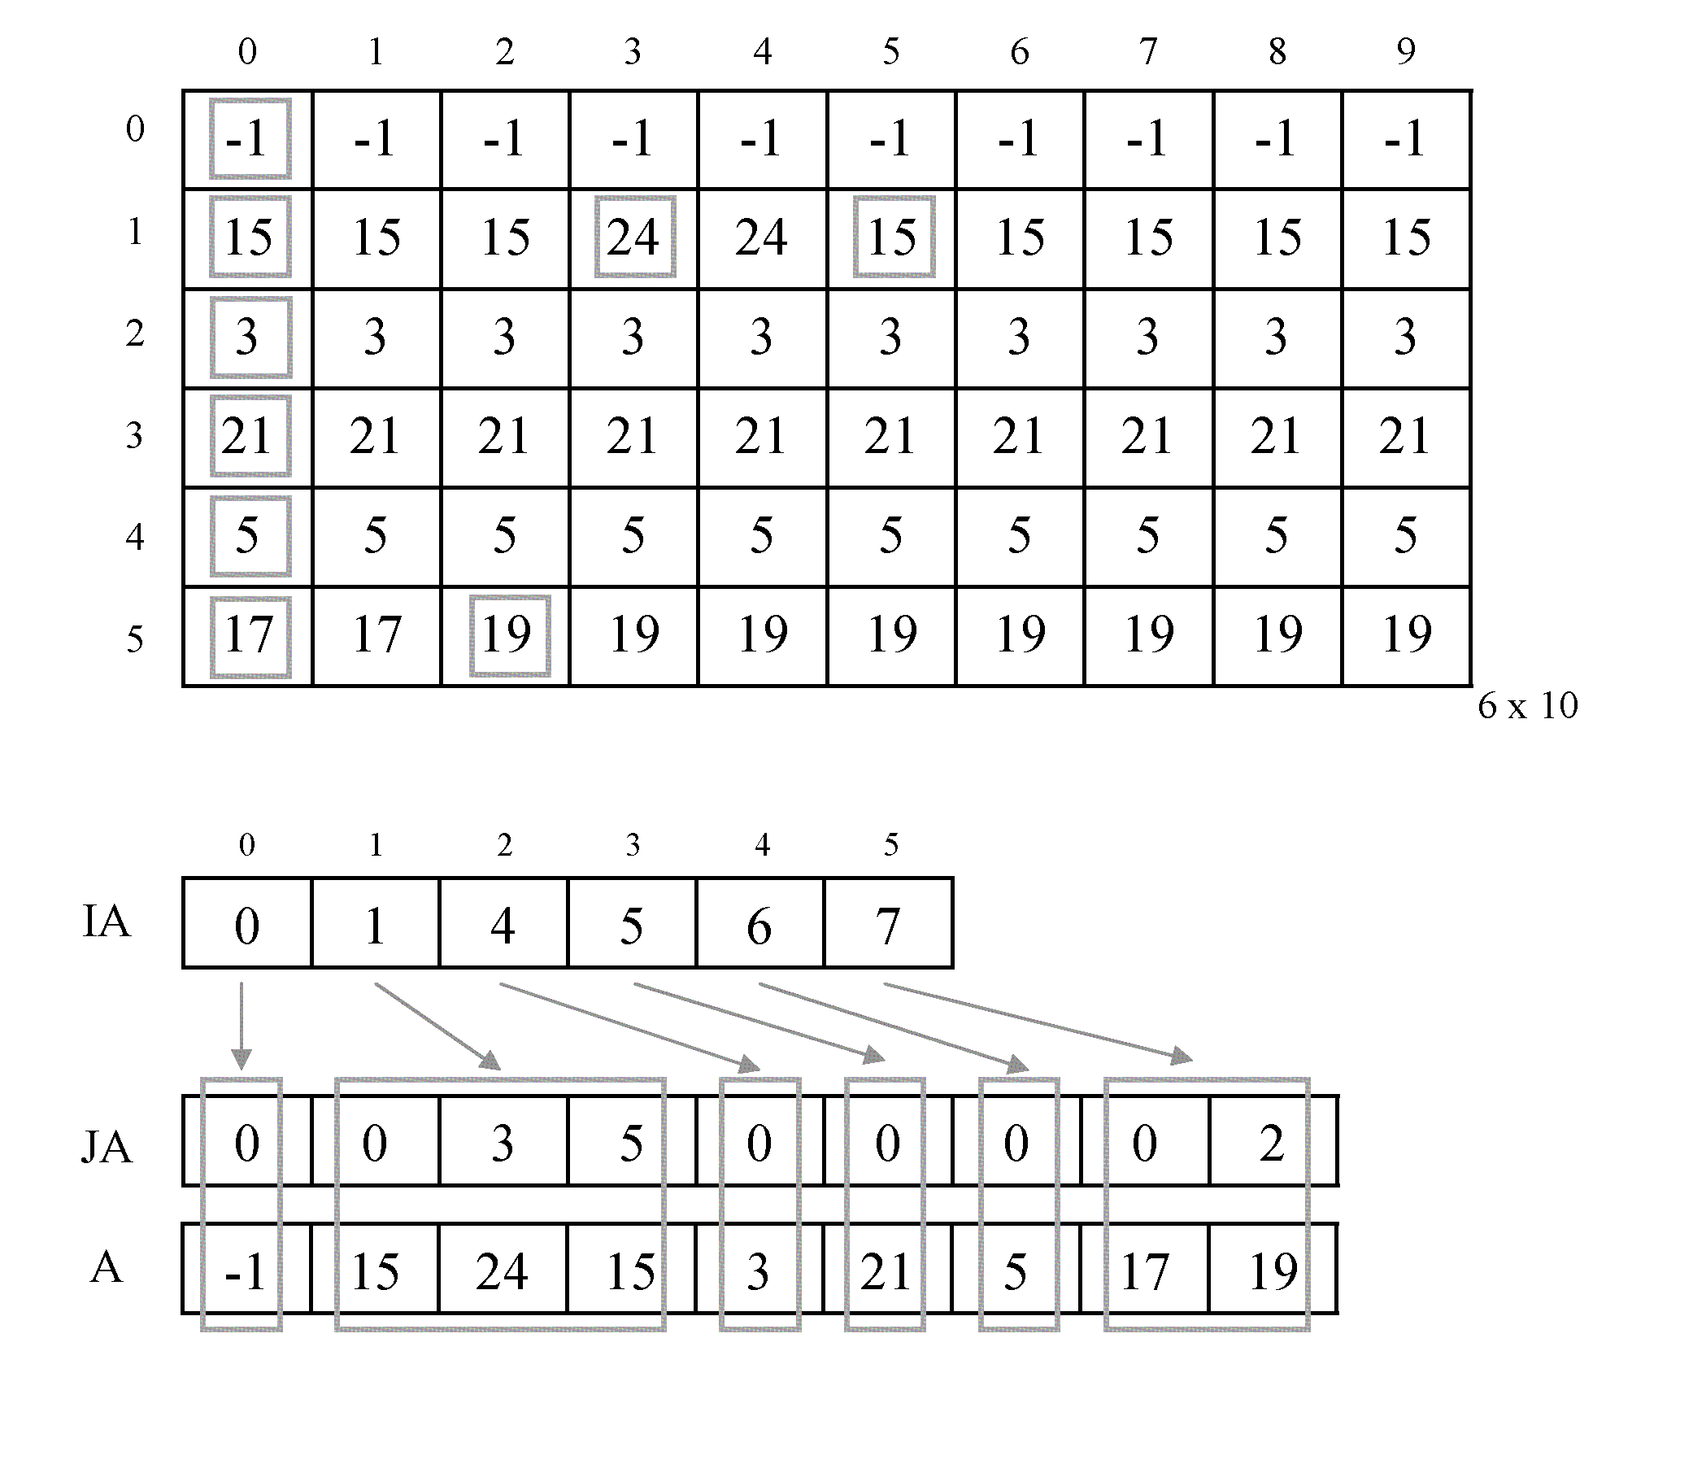
TIME-DEPENDENT SPS: YALE SPARSE MATRIX FORMAT
Example of Matrix C:
a_{ij} = cost of traveling from node i to node q at time instant j
IA(i) = position of column in array JA of node i
JA(i) = corresponding position of column in matrix C of node I (time departure)
Reduction of 60% in memory requirements
A(i) = travel time from node (i) to destination when departure time is JA(i)

